Slide 1
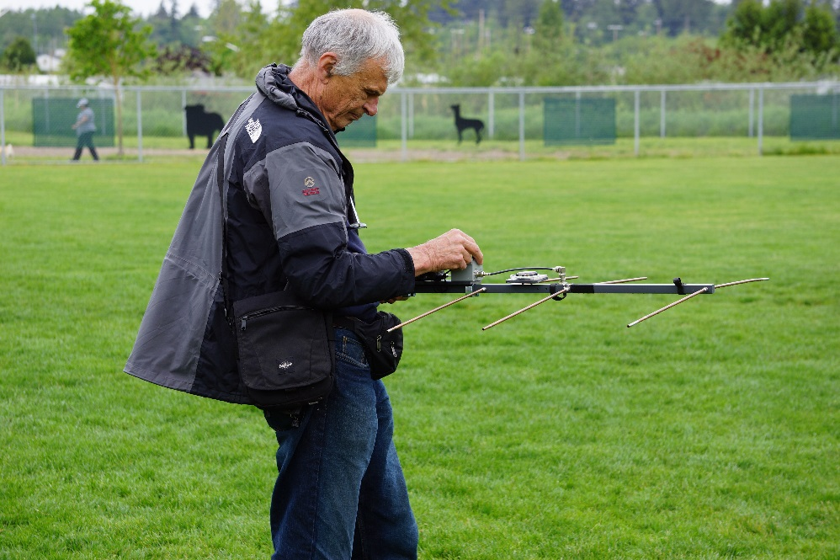
Radio Direction Finding
Communications Academy
2017
Michael A. Sterba
KG7HQ
Assistant director/technical specialist/ volunteer examiner
Northwestern division, arrl
April 22-23, 2017

Slide 2
Agenda
Introductions
Brief History
Skills Needed/ Skills Used
Starters Guide – Keeping it Simple (KIS)
Equipment and Toys
Let’s Experiment (Play Time!)
Front Page: W7CRW applying his skills toward locating a hidden transmitter.

Slide 3
Introductions
Name
Call-sign
QTH
Why are you here or what’s in it for me (WIIFM)?

Slide 4
Your Presenter and Tour Guide
Michael A. Sterba – KG7HQ
Assistant Director / Technical Specialist / Volunteer Examiner (Northwestern Division, Western Washington Section)
Amateur Radio Operator – 30 years, communications hobbyist 45 years
Professional
Boeing - 29 Years: Avionics Technician, Aircraft Systems Integration Designer, Aircraft Avionic Systems & Electrical Skills Instructor
US Navy – 25 years, Retired, : Chief Warrant Officer (7388), Avionics Technician, Anti-Submarine Warfare Technician, Tradevman (Flight Simulation Technician)
FCC General Radiotelephone w/RADAR Endorsement

Slide 5
What is Radio Direction Finding (RDF)?
Radio Direction Finding is defined as “the art of locating a signal or noise source with portable receivers and directional antennas”.
“Direction Finding (DF) can come into play when tracking down sources of interference on the ham bands, attentional or inadvertent, or when there is a suspected pirate (unlicensed ham station) in the area”.
In the emergency communications arena, DF can be used to locate Emergency Locator transmissions (ELT) or emergency beacons.
Question: What else can RDF techniques be used for?
(American Radio Relay League, 2011, p. 1.15)

Slide 6
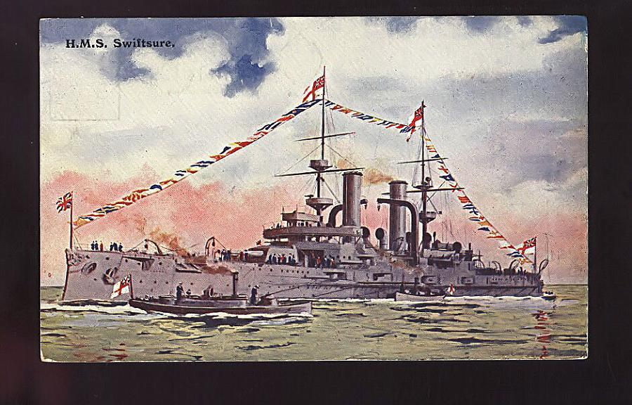
RDF has a long history…
RDF has been around almost as long as there been radio communications.
“Gained prominence in World War I through its usage by the British Navy to track enemy ships”
Today, it is used in support of:
Amateur Radio (Ham)
Citizens band (CB)
Civil Air Patrol (CAP)
Family Radio Service (FRS)
General Mobile radio Service (GMRS)
Law Enforcement
Military
Search and Rescue (SAR)
U.S. Coast Guard Auxiliary
(Naval History, 2017, p. 1)
(American Radio Relay League, 2011, p. 21.72)

Slide 7
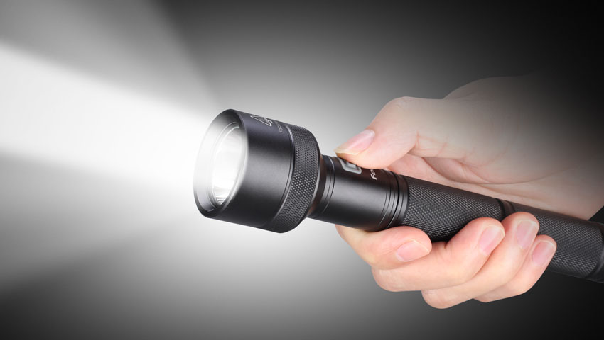
Based on Propagation
PROPAGATION means "movement through a medium." This is most easily illustrated by observing light rays.
When a light is turned on in a darkened room, light rays travel from the light bulb throughout the room. When a flashlight is turned on, light rays also radiate from its bulb, but are focused into a narrow beam.
But even with a narrow beam, surrounding areas also are lit as the light is reflected off adjoining surfaces.

Slide 8
Why are these skills needed?
Has anyone heard of Government budget cuts?
The Federal Communications Commission (FCC) isn’t a stranger to budgetary constraints.
Most monitoring and tracking happen via non-local remote systems and are not available for emergent or impromptu requests
Responses to interference cases may appear slow as resources are prioritized by criticality.
Emergent requirements may require quick response times for localizing a victim.
RDF isn’t just about driving around in circles till a source is located.

Slide 9
What are We Hunting?
In most cases, RDF is deployed to locate uncooperative actors.
Why is this important to note?
Most common types of targets are:
Broadcasters (including radar)
Communications transmissions
Malicious interference (e.g. attention seekers, jammers)
Transponders (Emergency Locator Transmitters (ELTs), Emergency Position Indicating Radiobeacon (EPIRB), etc.)
Unintentional interference (e.g. shared allocations, spurious emissions including, but not limited to, switching power supplies, LED lights, doorbell transformers, etc.)
Wildlife tracking

Slide 10
Skills Used
Individuals who have forensic mindset, and the ability to apply it, make for successful signal hunters…
Additional Skills that might help are:
Diplomacy
Listening
Mindset to Practice
Patience
Respect Boundaries
Sharing

Slide 11
How to start…
SAFETY IS NUMBER ONE!!!!!!!
Be fully aware of your surroundings!
Like a smartphone user, you can find harm's way quickly
When appropriate, wear high visibility safety vests, and hard hats
May be on foot taking measures, don’t assume others can see you.
Direction Finding while operating a motor vehicle is distracted driving
Have a partner to assist or just pull over in a safe location to take measures.
It is better to share your adventures in a forum such as this instead of from a hospital bed or worst

Slide 12
Basic Items
As with any facet of the communications hobby, proper equipment can distinguish the beginner from the experienced.
In addition to radio gear and maps, there are a couple of extras to consider:
Compass
Flashlight
Map light
Good Shoes
Spare Equipment
Snacks and water
Gloves
Vehicle
Safety Gear
(Moell & Curlee, 1987, p. 12)

Slide 13
Interference Sources
Are we trying to locate a noise source? Things most commonly found in the Pacific Northwest to cause interference are:
Along with the common dirty or malfunctioning electrical power standard (Poles) and electric fences:
Air purifiers/humidifiers, Aquarium heaters, CFL lights, Doorbell transformers, Electric blankets, Furnace control circuits, Heating pads, Invisible dog fences, Light dimmers, Photo-cells, Recessed ceiling fixtures, Switching power supplies, Touch lamps, TV’s, and Stereos (amplified antennas)
The list can go on forever!
NOTE: Don’t overlook that an ultrasonic sniffer can be very useful in these cases.

Slide 14
Getting bearings
Bearing can be defined as a horizontal direction of one point with respect to another or to the compass
The two most common methods are:
Manual
To gain the bearing, the operator manually points the antenna at the strongest signal
Automatic
An instrument automatically computes the bearing line based on a radiolocation methodology like Doppler or phase comparison
Which method is better??

Slide 15
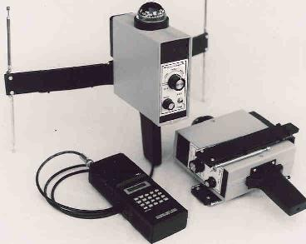
Pseudo-Doppler DF technique
The “pseudo-Doppler” technique is a phase based DF method that produces a bearing estimate on the received signal by measuring the Doppler shift induced on the signal by sampling around a circular array consisting of 2 or more elements.
Early versions used a single antenna that mechanically moved in a circle but has since been replaced using multi-antenna circular array with each antenna sampled in succession.
Common features for units using this technique are:
Electronic switching in the antenna system using PIN diodes and an audio rate
Gives indication of left/right toward the signal source
Indicated a single sharp direction to the signal source, but can be inaccurate in a multipathed area
(National RF Inc, 2017, p. 1)
(Moell & Curlee, 1987, p. 99)

Slide 16
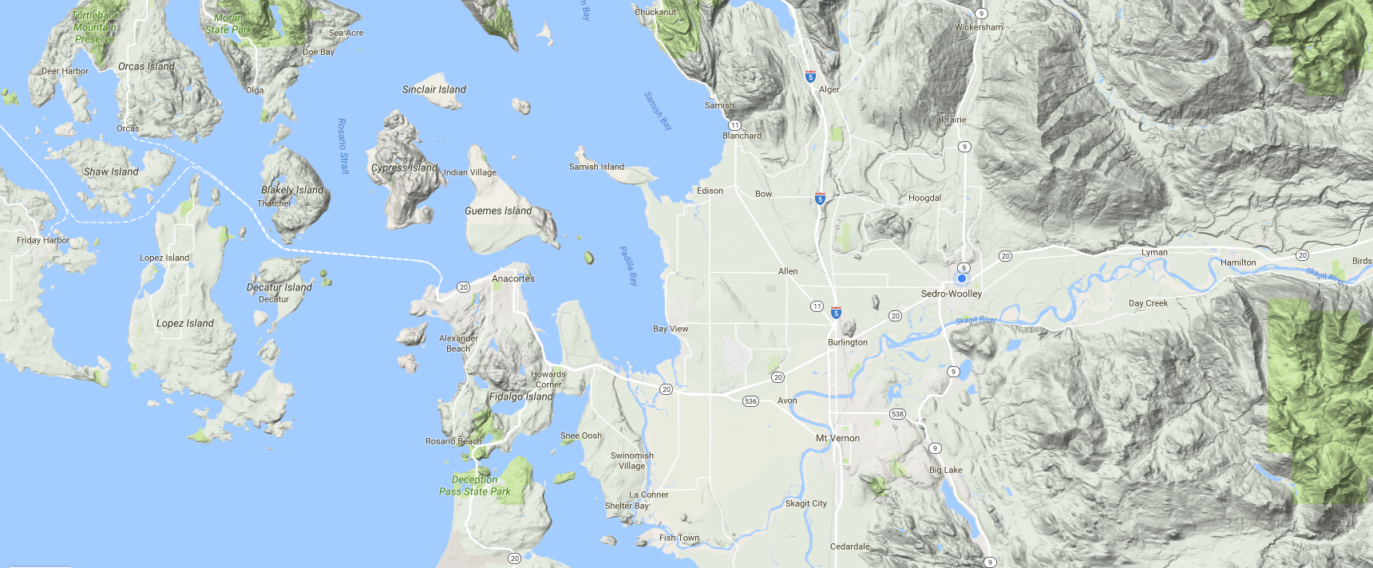
Theoretical bearings
N7GDE/R
145.190
4 element Yagi Cap Sante
Phased RDF
Mt Erie
15.91°E (WMM2015 magnetic declination)
(Google, 2017, p. 1)

Slide 17
Actual bearings… Why?
N7GDE/R
145.190
4 element Yagi Cap Sante
Phased RDF
Mt Erie
(Google, 2017, p. 1)

Slide 18
Theory… Salt Water, Reflections
N7GDE/R
145.190
4 element Yagi Cap Sante
Phased RDF
Mt Erie
(Google, 2017, p. 1)

Slide 19
Starting over…
N7GDE/R
145.190
Indicated Location from prior attempt
Triangulation pattern:
(Google, 2017, p. 1)
Notes:
Triangulation:
Can be defined as the tracing and measurement of a series or network of triangles in order to determine the distances and relative positions of points spread over a territory or region, especially by measuring the length of one side of each triangle and deducing its angles and the length of the other two sides by observation from this baseline. Source : https://www.google.com/#q=define+triangulation

Slide 20
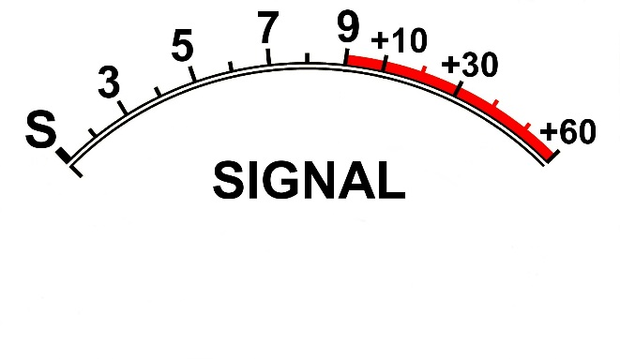
Some Thoughts on S-Meters
S-Meters are very handy as a signal strength reference, but can be VERY misleading
Great for getting a bearing from a directional antenna.
Can serve as a means to assess whether you are close to the source or not.
A reading of full-scale on FM can be only S5 on AM giving a false indication of closeness.
Circuit dampening can reduce responsiveness to rapid changes in received signals
Modern rigs have LED/LCD displays which may not be as accurate as an analog version.
Note:
Based on experience in the field:
When looking for direction, use FM
When looking for signal strength, use AM if available

Slide 21
Equipment and Toys
A brief pause for station identification and word from your presenter…
*RDF can be accomplished using a simple Handheld*
HT or handheld scanner, body shield, aluminum foil, cardboard, paper tube, etc.
Directional antennas, i.e., Yagi, quad, loops
Attenuators, dummy loads
Doppler units (See 73 Magazine, July 1990, Issue #358)
Smartphones w/USB TV Tuner Dongles
(Bohrer, 1990, p. 9)

Slide 22
Playtime
There is a hidden transmitter active….. Let's Find it!

Slide 23
Community of Practice (CoP)
“The term “community of practice” is of relatively recent coinage, even though the phenomenon it refers to is age-old. The concept has turned out to provide a useful perspective on knowing and learning. A growing number of people and organizations in various sectors are now focusing on communities of practice as a key to improving their performance”.
In most cases, RDF is deployed to locate uncooperative actors.
With a regional RDF group, locating signal sources can be coordinated and purposeful. When tapping from a community, the burden and experience can be shared allowing for rapid responders.
Why not organize?
(Wenger-Trayner & Wenger-Trayner, 2015, p. 1)

Slide 24
Conclusion
We covered:
Brief History
Skills Needed/ Skills Used
Starters Guide – Keeping it Simple (KIS)
Equipment and Toys
Let’s Experiment (Play Time!)

Slide 25
References
American Radio Relay League. (2011). ARRL Handbook. Newington: ARRL.
Bohrer, P. (1990, July). 73-magazine-Issue #358. Retrieved from Archive.org: https://archive.org/details/73-magazine-1990-07
Denisowski, P. (2015). An introduction to radio Direction Finding Methodologies. Retrieved from WIRELESS AT VIRGINIA TECH: https://wireless.vt.edu/symposiumarchives/2015_slides/document.pdf
GAB. (2014, July 01). GAB. Retrieved from GAB: http://gab.org/wp-content/uploads/2014/07/FCC-doorway.jpg
Google. (2017, February 13). Maps. Retrieved from Google Maps: https://maps.google.com/
Moell, J. D., & Curlee, T. N. (1987). Transmitter Hunting: Radio Direction Finding Simplified. Blue Ridge Summit: Tab Books.
National RF Inc. (2017, February 28). National RF Inc. Retrieved from National RF Inc: http://www.nationalrf.com/
Naval History. (2017, January 15). H.M.S. Swiftsure. Retrieved from Naval History: http://www.naval-history.net/PhotoWW1-01bbSwiftsure1PS.JPG
Wenger-Trayner, E., & Wenger-Trayner, B. (2015). Introduction to communities of practice. Retrieved from Wenger-Trayner: http://wenger-trayner.com/introduction-to-communities-of-practice/

